Slide 1
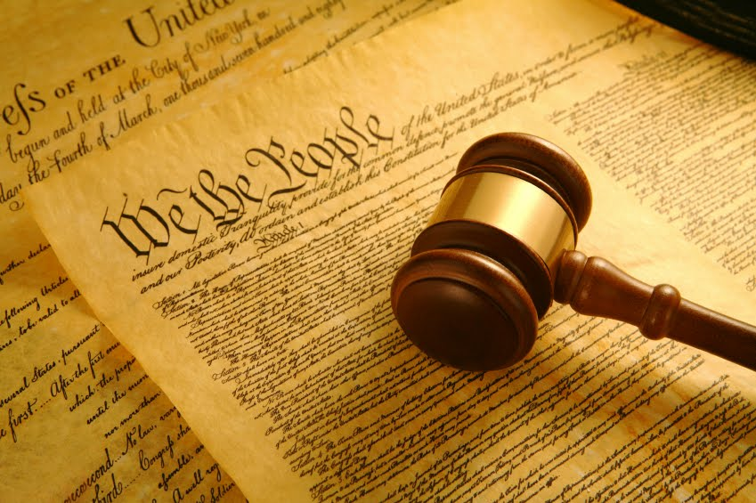
Meet “Rechtoe”
Hackathon for Good: Challenge The Hague Legal Tech Alliance
Team Thunderbolt AI
Using NLP to empower the rule of law
This Photo by Unknown Author is licensed under CC BY

Slide 2

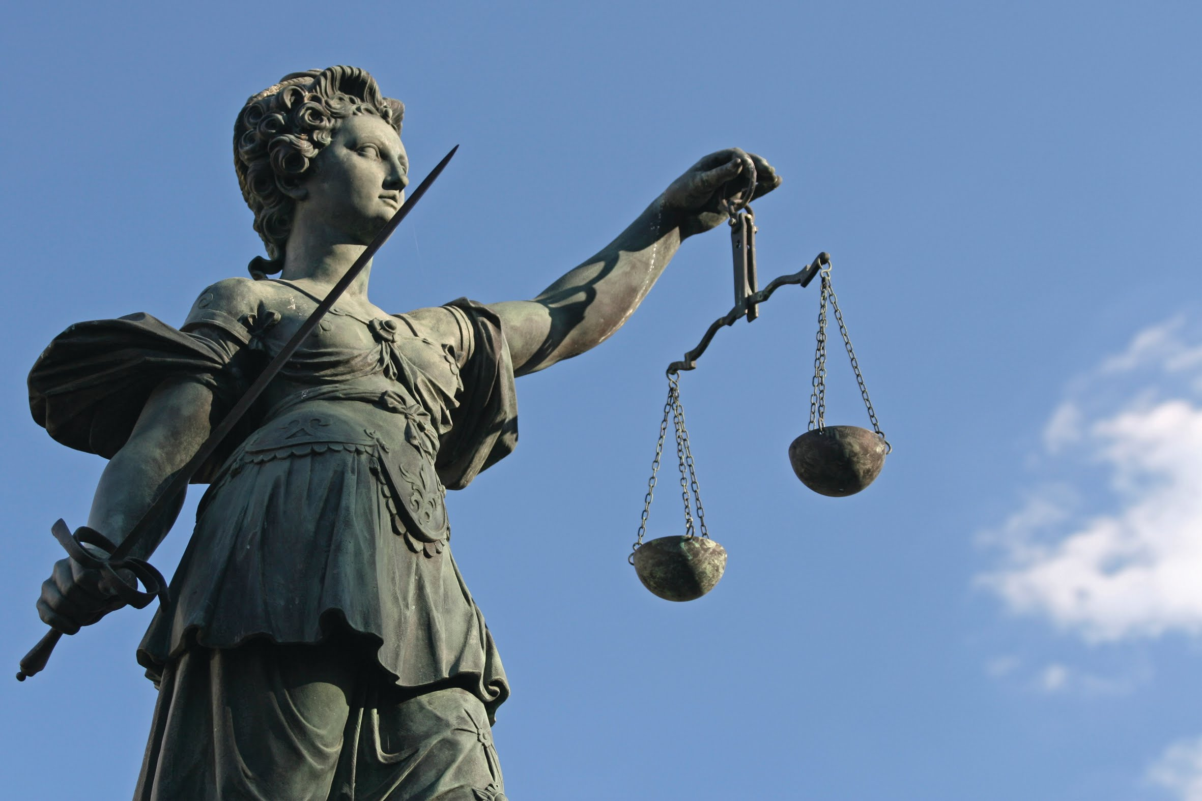

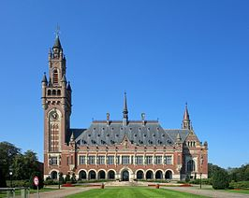
The Challenge
Equality in Rule of Law
Transparency
Automation & Privacy
City of Peace & Justice
All members of society are equally considered to be subject to publicly disclosed legal codes and processes
Only 3% of legal decisions in The Netherlands is publicly accessible
Giving access to law and jurisprudence through automatically created documents generated while protecting privacy
Maintaining the unique position of the city in the future

Slide 3
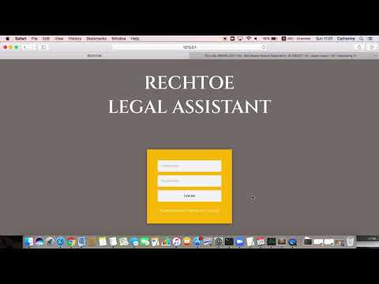
Rechtoe: a closer look at the process
Publicly available tools to input, label and process legal texts.
Notes:
A. Client APP-Document Processing+Automated Document Generation
B. Classified Documents (Levels of Secrecy Access) of the Output Documents.
C. Assigned RECHTOE Consultant to verify and sign off public releases.

Slide 4
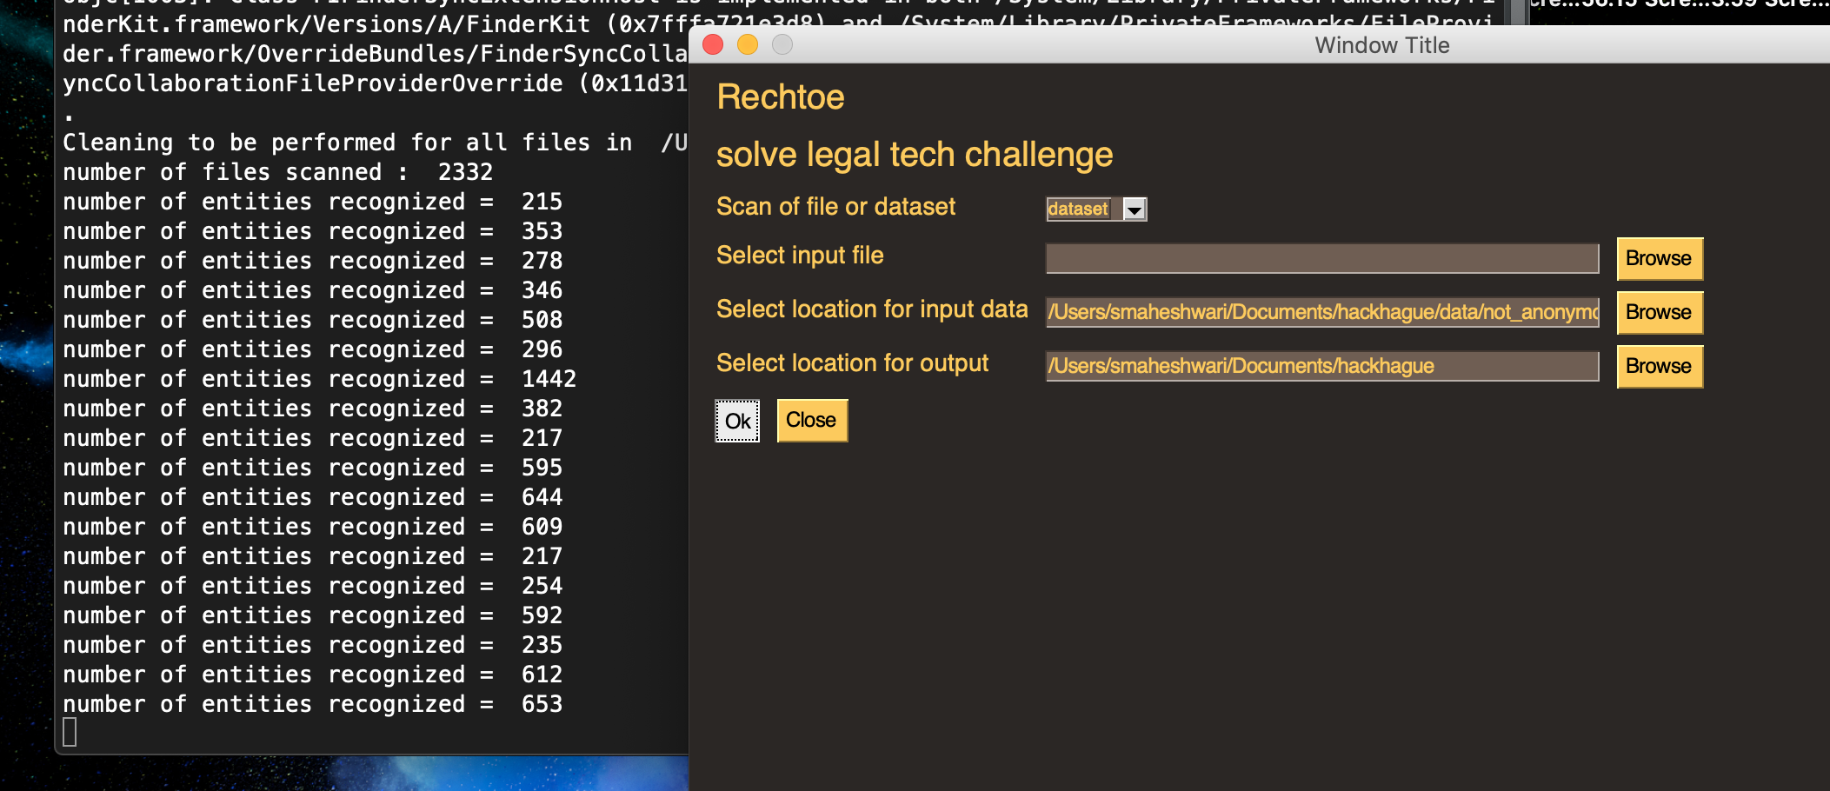
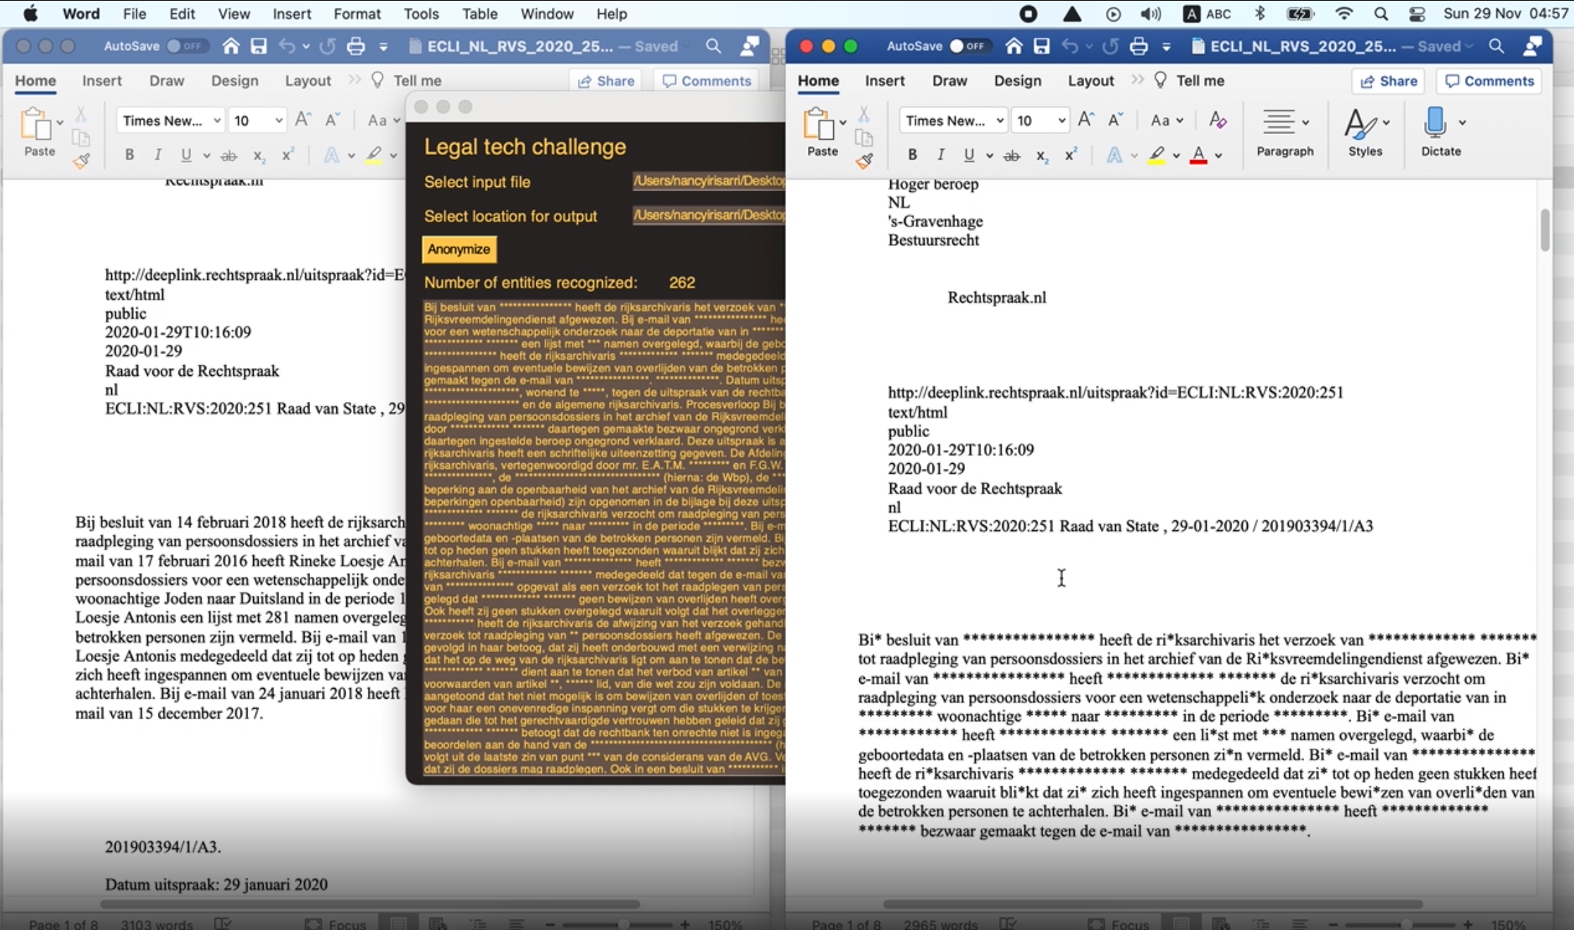
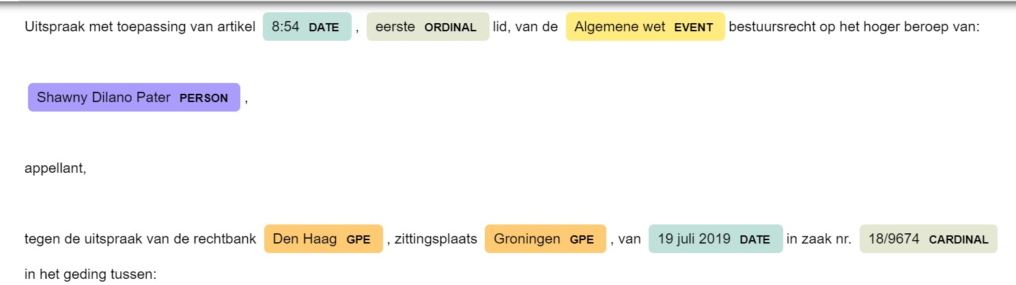
Rechtoe: a closer look at the process
Publicly available tools to input, label and process legal texts.
Notes:
A. Client APP-Document Processing+Automated Document Generation
B. Classified Documents (Levels of Secrecy Access) of the Output Documents.
C. Assigned RECHTOE Consultant to verify and sign off public releases.

Slide 5
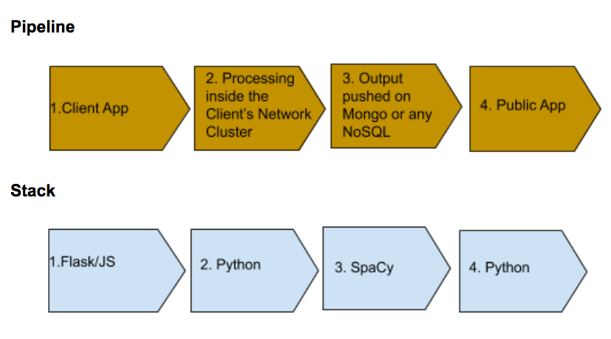
Rechtoe: a closer look at the process
Publicly available tools to input, label and process legal texts.
Notes:
A. Client APP-Document Processing+Automated Document Generation
B. Classified Documents (Levels of Secrecy Access) of the Output Documents.
C. Assigned RECHTOE Consultant to verify and sign off public releases.

Slide 6
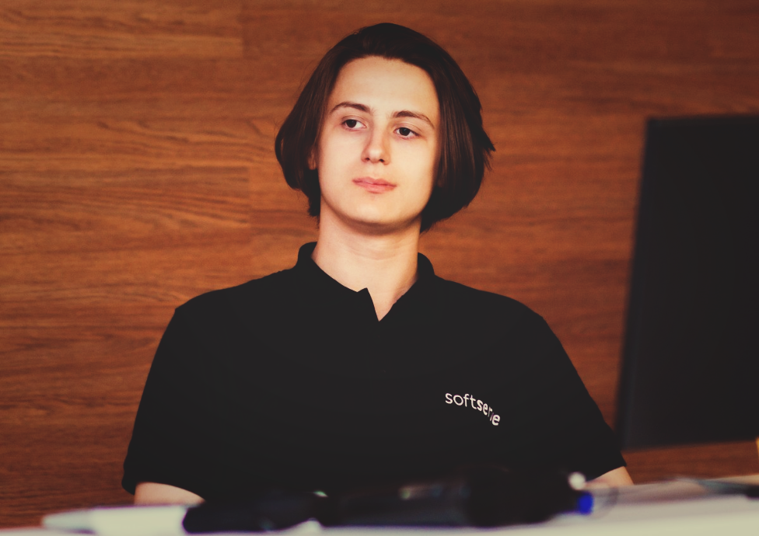
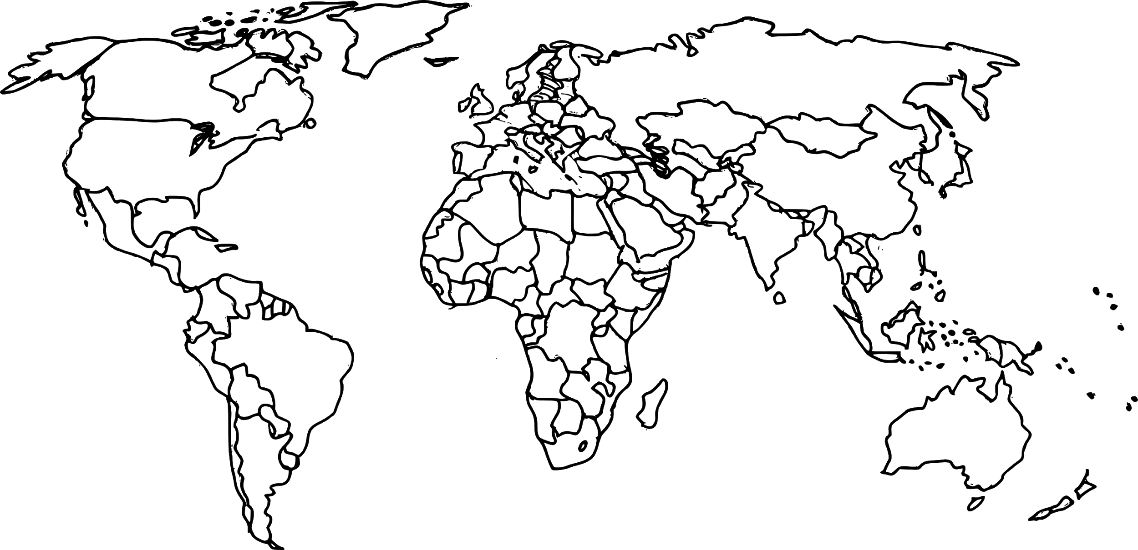

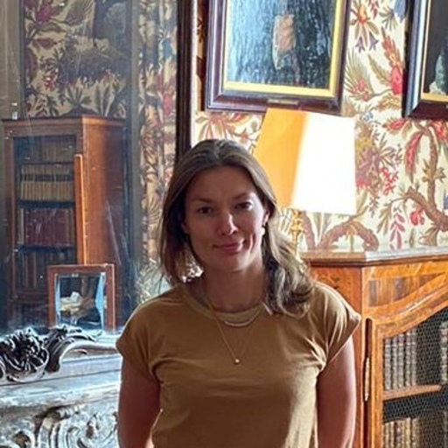



Meet Thunderbolt AI
Vladyslav Voloshyn
Talent for hire
Sonam Welekar
Katerina Novozhenova
Brilliant Data Detective & Scientist
CTO
Michael Nuehlen
Citizen Developer & Digital Humanist
Nancy Irisarri Méndez
Sudeep Maheshwari
Star Gazer & Data Scientist
Risk Taker Modeller

